Slide 1
COMP 249:
Object Oriented Programming II
Chap 9 – Exception Handling

Slide 2
Run Time Errors
Programs often don’t work as intended
We need a mechanism to determine when “exceptional” conditions have occurred

Slide 3
Traditional Error Handling
The C language approach
Errors must be checked at the point where they occur
  Typically, functions return an error code that is manually checked
x.doA();
if (doA went wrong)
handle the doA problems;
else
x.doB();
if (doB went wrong)
handle the doB problems
else
x.doC();
if (doC went wrong)
handle the doC problems
…
x.doA();
x.doB();
x.doC();
…

Slide 4
Traditional Error Handling
But…
  Code can become unreadable
    Mixture of application code and error handling
    Obscures the logic of the program
    Returning errors codes and values is awkward
  Programmers – even “good” ones - often skip a lot of error checking

Slide 5
Using Exceptions Instead
In Java, we use exception objects
An exception is an object that describes an unusual or erroneous situation
  ex: take the log of a negative number, division by zero, a file cannot be opened, null reference, …
A program is now separated into:
  the normal execution flow and
  an exception execution flow

Slide 6
Exception Handling
The default behavior if an exception occurs (i.e. the programmer did not account for it):
  the program terminates abnormally
  and produces an appropriate message
    The message includes a call stack trace that indicates:
      the line on which the exception occurred
      the sequence of method calls, starting at the method that threw the exception and ending at main

Slide 7
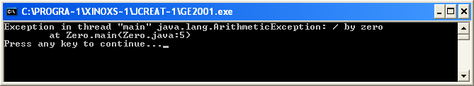
Example: Zero.java
public class Zero {
public static void main (String[] args) {
int numerator = 10;
int denominator = 0;
System.out.println(numerator / denominator);
System.out.println("This will not be printed");
}
}

Slide 8
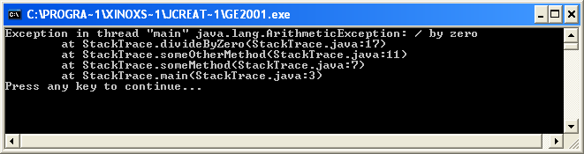
Example: StackTrace.java
public class StackTrace {
public static void main (String[] args) {
someMethod();
}
private static void someMethod() {
someOtherMethod();
}
private static void someOtherMethod() {
divideByZero();
}
private static void divideByZero() {
int numerator = 10;
int denominator = 0;
System.out.println(numerator / denominator);
System.out.println("This will not be printed");
}
}

Slide 9
Exception Handling Mechanism
Default behavior may not be fine for professional programs…
Exception Handling Mechanism allows us to change the default behavior to handle the exception more gracefully
We need to:
  attempt an operation
    normal flow is tried --> try statement
  indicate that something has gone wrong
    in case of trouble, throw an exception --> throw statement
  deal with the exceptional case when the operation does not succeed
    a handler catches the thrown exception and deals with it --> catch statement

Slide 10
Catching Exceptions
We use the try-throw-catch model
  try:
    a block of code in which exceptions can be generated
  throw:
    allows to generate an exception
  catch:
    a handler for a particular type of exception

Slide 11
Structure of try-catch-finally
try {
<some code>
<either some code with a throw statement
or a method call that might throw an exception>
<some more code>
}
catch(ExceptionType1 e) {
<exception handling code>
}
catch(ExceptionType2 e) {
<exception handling code>
}
…
finally {
<code to execute whether an exception was thrown or not>
}

Slide 12
try-catch-finally
The try block
  includes the line that throws the exception (directly or not)
  is followed by one or more catch clauses
Each catch block:
  contains code to process an exception
  has an associated exception type
  is called an exception handler
  If an Exception is thrown inside of a try block, the exception that is returned is forwarded as an argument to the catch block where the Exception can be handled

Slide 13
try-catch-finally
the finally block:
  optional
  The statements in the finally clause:
    are always executed
    Run before Java moves up the call stack
  useful to run important code that needs to be run at the end of the try block even if an exception is thrown
    ex: closing a file opened in a try, …
  If no exception is generated,
    the finally clause is executed after the try block completes
  If an exception is generated,
    the finally clause is executed after the appropriate catch block completes

Slide 14
Example
if you call a method like Integer.parseInt()
and the input is not in the correct format, a NumberFormatException is thrown automatically.
int x;
try {
x = Integer.parseInt("abc");
}
catch (NumberFormatException e) {
System.err.println(“You must enter an integer”);
}

Slide 15
2 things can happen
If an exception is not thrown:
  All of the statements in the try block executes normally.
  The code in the catch block is not executed.
  The code in the finally block is executed.
If an exception is thrown:
  In the try block, only the code up to the line that throws the exception is executed.
  The code after the line that throws the exception is not executed.
  The code in the appropriate catch block is executed.
  The code in the finally block is executed.

Slide 16
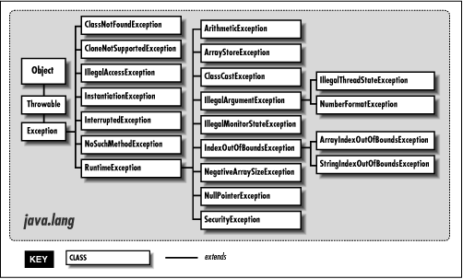
The Exception Hierarchy
When an exception is thrown, one of these exception classes is instantiated
ex of methods in Exception class:
  getCause()
  getMessage() returns a string explaining why the exception was thrown
  printStackTrace()

Slide 17
Multiple Exceptions and catch Blocks
The try block can generate multiple exceptions
The catch blocks are tested in sequence for one that catches the exception type
Java will execute the first matching handler
Will not execute other handlers once it has a match
…So put the catch blocks for the more specific
exceptions early and the more general ones later
--> Catch the more specific exception first

Slide 18

Example: MultipleExceptions.java
try {
String a = "0";
int r2 = Integer.parseInt(a) / Integer.parseInt(a);
}
catch (ArithmeticException e) {
System.out.println("Calculation Error");
}
catch (Exception e) {
System.out.println("General Exception");
}
finally {
System.out.println("Finally");
}
System.out.println("Finished");
output?

Slide 19
What if…
try {
String a = "0";
int r2 = Integer.parseInt(a) / Integer.parseInt(a);
}
catch (Exception e) { // general exception first
System.out.println("General Exception");
}
catch (ArithmeticException e){
//specific exception after
System.out.println("Calculation Error");
}
finally {
System.out.println("Finally");
}
System.out.println("Finished");
output?

Slide 20
Example: Which exception to catch?
public class MyClass {
public static void main (String[] args)
{
try {
String text = "abcde";
System.out.print(text.charAt(10));
int r1 = Integer.parseInt(text);
}
catch (ArithmeticException e) {
System.out.println("Calculation Error!");
}
System.out.println("Finished!");
}
}
output?

Slide 21
throw Syntax
try {
<code to try>
if (test condition)
throw new Exception("Msg to display");
<remaining code that will execute only if exception is not thrown>
}
catch (SomeException e) {
<exception handling code>
}
…
finally {
<code to execute whether the exception was thrown or not>
}

Slide 22
throw: What happens?
when we hit the throw statement,
  Execution stops immediately
  Any subsequent statements are not executed
  Looks for matching catch statement
    Match found --> control is transferred to that statement
    No match --> control propagates to caller

Slide 23
Example: Bank Account
First draft…
public class BankAccount {
public void withdraw(double amount) {
balance -= amount;
}
…
}
but what if the amount to withdraw is > current balance…
public class BankAccount {
public void withdraw(double amount) {
}
…
}

Slide 24
Example: Bank Account
better…
public void withdraw (double amount) {
try
{
}
catch
{
}
}

Slide 25
More likely use of try-catch
exception handler may or may not be inside the method that produced the problem
try {
<code to try>
someMethod();
<more code>
}
catch (SomeException e) {
<exception handling code>
}
<possibly more code>
void someMethod() throws SomeException
{
<some code>
if (error)
throw new SomeException("message");
<more code>
}
call
normal return
return from thrown exception

Slide 26
What if no match?
if the try clause generates an exception that you don’t catch?
  either, because you did not think about it…
  or, it is more appropriate to handle the exception at a higher level
    Remember: you should place a catch block only in methods that can competently handle this particular exception
then, the exception is passed up the call stack
  i.e. exception propagates up through the method calling hierarchy until it is caught and handled or until it reaches the main method
  Goes all the way back to main if necessary
  Program terminates with a stack trace
so an exception is either:
  caught or
  ends up at the JVM who halts the program (default behavior)

Slide 27

Just Checking
Try blocks contain code that could possibly:
Handle an exception
Throw an exception
Catch an exception
Display an exception
2 of the above answers

Slide 28
Just Checking
The catch block has _______ parameters.
zero
one
two
three
As many as you need

Slide 29
Just Checking
A ___ block should immediately follow a try block.
try
catch
fail
final

Slide 30
throws statement
A throws-clause is used when defining a method, to declare
  that it may throw an exception
  but the exception is not caught in the method
Use a throws-clause to:
  "pass the buck" to whatever method calls it
    i.e. pass the responsibility for the catch block to calling the method
    the calling method can also pass the buck… but eventually some method
    must catch it
  tells other methods "If you call me, you must handle any exceptions that I throw."
public class String {
public char charAt(int index) throws IndexOutOfBoundsException {
...
throw new IndexOutOfBoundsException();
...
return c;
}

Slide 31
Passing the Buck
Method A()
Good programming practice:
Every exception thrown should eventually be caught in some method
Normally exceptions are either:
  caught in a catch block or
  deferred to the calling method in a throws-clause (passing the buck)
If a method throws an exception:
  the catch block must be in that method
  unless it is deferred by a throws-clause
  the calling method can also defers with a throws-clause, etc., up the line all the way to main, until a catch block is found or the program terminates
B();
does not catch X
Method B()
C();
does not catch X
Method C()
D();
does not catch X
Method D()
throw exception X

Slide 32
Recap:
You have 2 choices with exceptions
Handle the exception locally
  Use try/catch clause
Pass the exception up the stack
  If you can't competently handle it
  Add a throws clause to method signature
  No catch clause
  Let some other ancestor method handle it
  If no one handles it, program will terminate

Slide 33
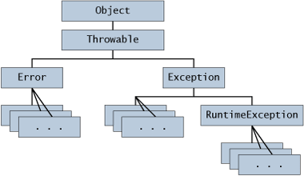
The Throwable Hierarchy

Slide 34
What’s the Difference?
Error
  Serious system problem
    ex: out of memory, linkage error, …
RunTimeException
  Programming errors
    ex: Divide by zero, array index out of bounds, null pointer, …
  You should find them in your testing phase

Slide 35
Defining your own Exception Class (p. 527)
If you use a predefined, more general exception class
  --> then your catch-block could also catch exceptions that should be handled somewhere else.
A specific catch-block for your own exception class will catch the exceptions it should and pass others on.
You can create new exceptions if you need them
  Usually over-ride the Exception class or some sub-class
Can add other methods if you like

Slide 36
Constructors for your exception class
Two basic constructors
class myException extends Exception {
// Default constructor
public myException() {}
// Constructor with message
public myException(String msg){
super(msg);
}
}

Slide 37
Example
public class DivideByZeroException extends Exception
{
public DivideByZeroException() {
super("Hey! you're trying to divide by zero!");
}
public DivideByZeroException(String message) {
super(message);
}
}
this code only defines the exception class…
to use it, you must throw and catch the exception where you need it

Slide 38
Example
class InsufficientFundsException extends RuntimeException
{
public InsufficientFundsException () {}
public InsufficientFundsException (String message) {
super(message);
System.err.println("The bank will contact you.");
}
}

Slide 39
Example: Bank Account
even better…

Slide 40
Can create your own methods
see ExtraStuff.java

Slide 41
Checked and Unchecked Exceptions
For some kinds of exceptions, the compiler makes tight checks that a throw clause has a corresponding catch statement
Checked exception (checked by compiler)
  the compiler requires you to deal with them
  catch or declare rule: if a method throws an exception, then it must handle it
    i.e. it must catch it or declare it in the header with a throws clause
    otherwise --> compilation error.
Unchecked exception (not checked by compiler)
  the compiler does not require you to deal with them
  if a method states that it can throw an exception (with a throws clause)
    the calling methods do not have to handle the exception
  a method can throw an exception even if it is not stated in the header with a throws clause

Slide 42
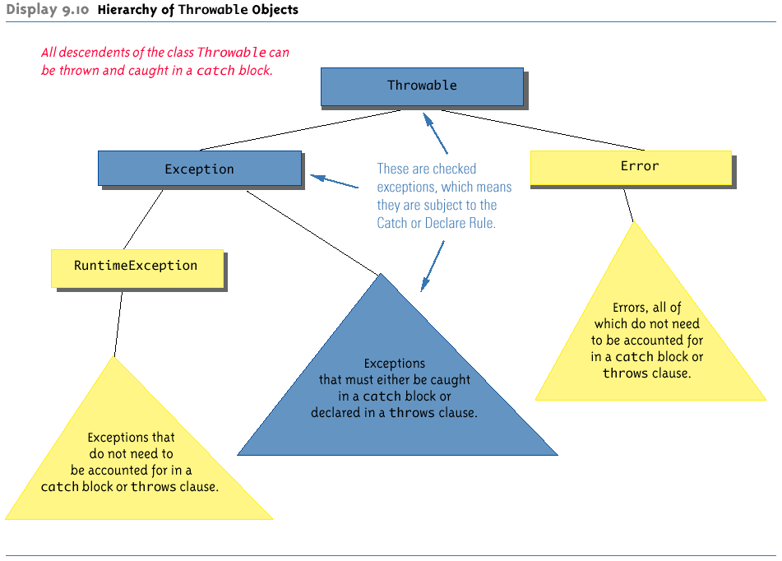
The Throwable Hierarchy

Slide 43
Unchecked Exceptions
Catch or Declare Rule does not apply
May result from
  RuntimeException:
    can occur very frequently, but are the programmer's fault
      ex: null pointer, number format exception, index out of bounds, …
    programmer's choice to deal with them or not
  Error:
    Serious external conditions that are difficult to fix
      ex: out of Memory, linkage error, …
You should refrain from throwing these

Slide 44
Checked Exceptions
Catch or Declare Rule applies
Typically due to:
  Unexpected conditions -- often when dealing with I/O
    ex: file not found, disk error, broken network, …
  Not programmer's fault
    likely to occur no matter how careful you are

Slide 45
Just Checking
Exceptions hat are subject to the catch or declare rule are called
Checked exceptions
Unchecked exceptions
Fatal exceptions
All of the above

Slide 46
Just Checking
When defining your own exception class, you extend an existing exception class. This is an example of:
polymorphism
encapsulation
inheritance
Catch or declare rule
All of the above

Slide 47
Just Checking
All exception are descendants of the class:
Object
Throwable
Catchable
Tryable
2 of the above

Slide 48
Just Checking
A runtime exception is a/an:
Checked exception
Unchecked exception
Both A and B
None of the above

Slide 49
Example 1: FileNotFoundException
BufferedReader inFile = new BufferedReader(new FileReader("myfile.txt"));
FileReader can throw a FileNotFoundException (checked)
so provide a catch:
or, pass the exception up to the calling method:
private void theMethod() {
try {
…
BufferedReader inFile = new BufferedReader(new FileReader("f.txt"));
…
}
catch (FileNotFoundException e) {
System.err.print(e.getMessage());
…
private void theMethod() throws FileNotFoundException {
…
BufferedReader infile = new BufferedReader(new FileReader(".txt"));
…
}

Slide 50
Example 2: NumberFormatException
int number = Integer.parseInt(someString);
parseInt can throw a NumberFormatException (unchecked)
so, we can just ignore it…
or provide a catch:
or, pass the exception up to the calling method:
private void theMethod() {
try {
…
int number = Integer.parseInt(someString);
…
}
catch (NumberFormatException e) {
System.err.print(e.getMessage());
…
private void theMethod() throws NumberFormatException {
…
int number = Integer.parseInt(someString);
…
}

Slide 51
Example 3: ArrayIndexOutOfBounds
int a[] = new int[10];
for (int n = 0; n <= 10; n++) {
a[n] = 0;
}
can throw a _______________________________ (checked?)
so?

Slide 52
Rethrowing Exceptions (p. 559)
You can “rethrow” an exception after catching it and processing it
Useful if current method wants to catch the exception, but the calling method too.
try {
String text = “text”;
System.out.println(text.charAt(10));
}
catch(IndexOutOfBoundsException e) {
System.err.println(“Index out of bounds”);
e.printStackTrace();
throw e;
}

Slide 53
throws and overriding
The throws clause in the declaration of a method must be compatible with all its overridden declarations
  the overriding method (in the child class)
    May have less Exceptions
    May have subclasses of the Exceptions thrown by the superclass method.
You cannot add a new checked exception, that was not in the original throws

Slide 54
Throws and overriding see: ExceptionsAndOverRiding.java
public class Parent {
public void someMethod() throws Exception
{…}
}
public class Child extends Parent {
public void someMethod() throws java.io.IOException
{…}
}
public class GrandChild extends Child {
public void someMethod()
{…}
}
public class BadChild extends Child {
public void someMethod() throws Exception
{…}
}

Slide 55

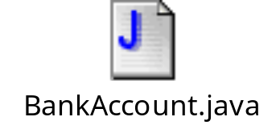
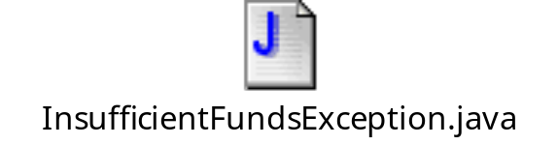

A Big Example
see:

